Slide 1


MetLife Updates
Christine Sturgill, Senior Account Executive
August 30, 2022

Slide 2
Broadest range of products
Life
Supplemental Health
Global
Basic Term Life
Accidental Death & Dismemberment
Group Variable Universal Life
Group Universal Life
Supplemental Term Life
Voluntary Retiree Life
Dental
Vision
Short Term Disability
Long Term Disability
Individual Disability Income
Reserve Buyout
Total Absence Management
Expatriate Benefits
Multi-National Solutions
International Business Travel
Accident & Health
Retirement & Income
Specialty
Accident
Cancer
Critical Illness
Hospital Indemnity
Retiree Life Solutions
Retirement Income Solutions
Fixed Income Annuity
Auto and Home
Business Travel Accident
Financial Wellness
Upwise®
Legal Services
Pet
Identity & Fraud Protection: Aura
HS & SA
Employee Engagement
Benefit Administration Firms
Communication Firms
Notes:
Message: The breadth of MetLife’s Group Benefit products is unmatched in the industry – giving brokers and employers a wide range of options to put together the right coverage combination to fit almost any situation.
We have 18 products which is the broadest product portfolio available and is designed to support multi-generational needs and employer budgets
The Life, Supplemental Health and Specialty product options serve as building blocks so it’s easy to mix and match to create and refine a benefits program to suit employee needs and business objectives.
Voluntary products help employees make confident decisions on how best to protect themselves and their families
What’s more, with so many products to offer, we give employers the opportunity to leverage our portfolio through holistic underwriting, streamlined communications, consolidated interfaces and other benefits from having fewer carriers.

Slide 3






Work with MetLife to create product bundles that help meet your clients’ needs
Work directly with us to build bundles from our broad product portfolio that represent a unique offering you can bring to your clients
SAMPLE PRODUCT BUNDLES:
1
2
3
4
+
+
+
+
+
+
+
Dental and
Vision
Disability and Life
Life & Disability +
Supplemental Health
Dental & Vision +
Supplemental Health
POTENTIAL BENEFITS OF BUNDLING:
Added Flexibility
Potential for extended rate guarantees and discounts
Simplified implementation and dedicated service
Broader financial protection for employees
Increased employee satisfaction
Notes:
For Disability and A&H, highlight the Connected Benefits Experience available with these products (see Connected Benefits stewardship deck slide for positioning)
Added Flexibility
Our products are designed to give you the flexibility you need to offer competitive and creative solutions. Collaborate with our experts to create plan design options that achieve the right balance between cost and coverage needs. Plus, you can help clients stabilize their budgets and plans for the future with packaged pricing options, that may include rate guarantees and rate caps.
Dedicated Service
Your clients (and you) gain added value by offering multiple benefits from one carrier. From streamlined implementation and eligibility to dedicated sales and service partners, we can help make benefits simpler to navigate.
Dedicated Account Manager focuses on your book of business, which makes collaboration and service escalation easy.
Dedicated Client Service Consultant provides a single go-to service contact for each client across products.
Day-to-day contacts are backed by a team of onboarding, billing and claims experts dedicated to getting answers back to you and your clients quickly.
Simplified eligibility and billing solutions designed to provide a streamlined process for data transfer and easy to administer payment and reconciliation methods
Comprehensive Experience
- Engaging employee enrollment experiences offer a range of action-oriented options to help you deliver simple, flexible, and intuitive solutions to your clients.
- Employee targeted communications and capabilities that have cohesive, look and feel

Slide 4


Accelerating growth through a comprehensive broker block strategy
Designated resources and operational model to assess, implement and service blocks of multi-customer business transactions. Block strategies could be explored if there is a valid basis for treating multiple employer groups as a block
POTENTIAL OPPORTUNITIES
DISCIPLINED APPROACH
Service issues
Carrier market exit
Industry verticals
Consolidation
Formal assessment process
Dedicated resources - underwriting, contracts and service
Third party support with Euclid Managers
Competitive compensation
POTENTIAL BENEFITS OF BUNDLING:
Evaluation and aggregation of multiple employer groups
Create industry verticals specific to your book of business
Dedicated resources with simplified and streamlined service model
Administrative efficiencies by consolidating your business with fewer carriers
Value-added services not typically accessible to all market segments
Notes:
We recognize that there could be opportunities within your book of business that could benefit from consolidating carriers – whether due to service issues with the current carrier, or additional efficiencies that could be gained from your service teams.
In response to these opportunities, we have developed a disciplined approach to assess, implement and service these multi-customer blocks of business. Dedicated resources across our organization including specialists in underwriting, contracts and service will ensure that we develop the best transition plan for your clients, matching current plan designs and rates where possible, while providing the customer experience that you expect from MetLife. Our dedicated resources can review opportunities within your book of business to evaluate the aggregation of two or more employer groups across industry verticals.
In addition, for situations that involve associations or Professional Employment Organizations (PEOs), we have expert resources available through our Specialty Market sales and service team that will help us navigate through to the best benefit solution for your clients.
Watch the RM Block Takeovers training delivered in October 2018: https://my.metlife.com/sites/LearningSolutions/SitePages/Training%20Replays.aspx
Additional information: https://my.metlife.com/sites/LearningSolutions/Lists/All%20Training/Attachments/526/RM_BlockTake-over_FINAL_L0918508779[exp1119][All%20States].pdf

Slide 5
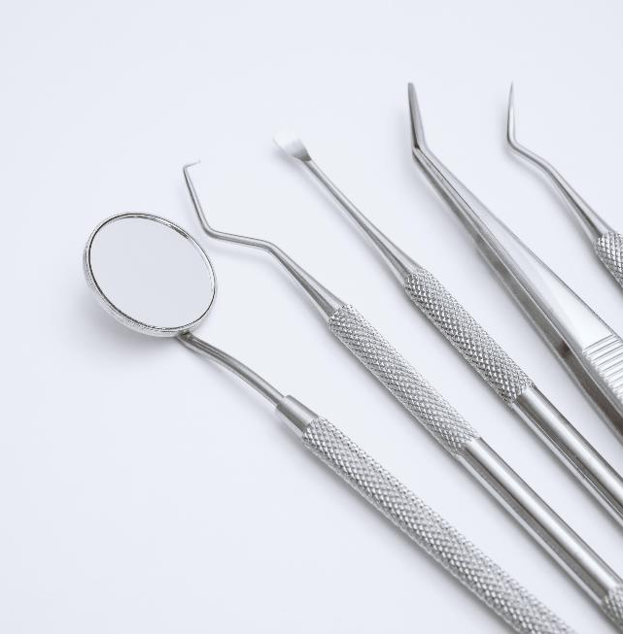
Dental Updates

Slide 6
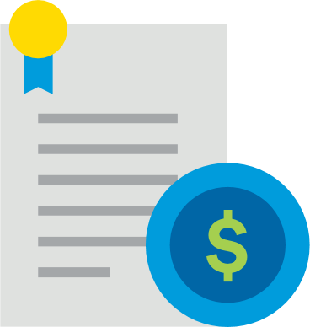
Plans and Capabilities to Fit the Needs of Your Organization and Employees
Plans to incentivize
preventive care¹
New plan feature available: Type A services do not apply toward Annual Maximum
Annual maximum and/or coinsurance levels
increase over a 2-3 year period
Applies to all members of a family individually;
they could have different benefit levels
2022 availability for groups 100+ eligible, can quote <100 if in-force
Notes:
MESSAGE: The second most important aspect of a dental benefits program outside of the network is the plan design and often they have not been modernized to reflect the latest innovations in dentistry, research and market benefit trends.
Outside of the dental network the second most important aspect of a dental benefits program is the plan design. However, many of today’s plan designs may not have been modernized to provide the most value to both employees and to employers. A plan design that has been strategically built based upon the latest relevant evidence based research, current protocols on how dentists practice, as well as market benefit trends can help to save money for plan participants and employers while encouraging appropriate and necessary care. MetLife provides a high level of consultative expertise for employers around these three components when evaluating an employer’s program. Recommendations for plan designs are developed with the aid of in house clinical experts who are all dentists along with MetLife’s Dental Advisory council which is made up of academic dentists from the nation’s dental schools as well as practicing dentists. These experts make sure the recommendations align with current standards of dental care backed by clinical research as well as alignment with current practice protocols developed on how dentists practice today. Also, the current market trends are considered where benefit dollars are redistributed in a mindful manner based upon what services plan participants need and want. This is a consumer based model where services that prevent and treat disease are benefitted at a higher level than more elective dental procedures.
In addition to network, plan design is a key component of any dental benefit plan. When you think about it, dental benefits have not changed that much for decades but dentistry and technology have. 15-20 years ago, a crown was only expected to last 5 years. Now a crown is expected to last 10+ years, yet we still see plan designs with crown replacement at 5 years. Our approach to plan design is consultative. We believe a good dental plan is based on valid clinical research and that the benefits should align with dentists’ practice protocols. We also recommend that your plan consider market trends, meaning that it deliver coverage for services that employees value. While we have an abundance of flexibility when it comes to plan design, our recommended standards are based on this philosophy.
[If making plan design change recommendations. . . ] The next couple of slides highlight some changes we are recommending to your current plan design. . .

Slide 7

Understanding the benefits of Clear Aligner Therapy
SmileDirectClub will be available through MetLife Dental
Employees receive discounts depending
on their orthodontia coverage
    With coverage
    $210 discount
    with complimentary whitening kit and ortho scan
MetLife-credentialed dentists
meet quality standards¹
    Without coverage
    $110 discount
    with complimentary whitening kit and ortho scan
¹Certain providers may participate with MetLife through an agreement that MetLife has with a vendor. Providers available through a vendor are subject to the vendor’s credentialing process and requirements, not MetLife’s. If you should have any questions, contact MetLife Customer Service.
Notes:
Clear Aligner Therapy:
Clear aligner therapy is ortho with a clear appliance much like an athletic mouth guard vs. silver brackets. There are many options available to consumers and MetLife has made sure to establish relationships and make options available to our dental plan participants.
Smile Direct Club – SmileDirectClub dentists are now in network and available through MetLife Dental.
Employees can get a discount if orthodontia is a part of their dental plan or not:
$210 discount for employees of companies with orthodontia coverage. They will also receive a free whitening kit and free ortho scan
$110 discount for employees of companies without orthodontia coverage. They will also receive a free whitening kit and free ortho scan
For companies with orthodontia coverage, services provided by SmileDirectClub dentists are reimbursed under the plan’s orthodontia treatment (because we are credentialing all of their dentists in our network).
Our plan offers:
A free 3D digital image at one of 235 SmileShops ($0 cost) or an at-home impression kit ($0 cost with rebate)
bright on™ premium teeth whitening ($0 cost)
You’ll be assigned a duly licensed dentist or orthodontist to develop your treatment plan and monitor your progress
* Certain providers may participate with MetLife through an agreement that MetLife has with a vendor. Providers available through a vendor are subject to the vendor's credentialing process and requirements, Not MetLife's. If you should have any questions, contaict MetLife Customer Service

Slide 8
We stay ahead of technology that’s ever-evolving
Enhanced MyBenefits
Claim Center
Mobile App
Text Notifications*
(future enhancements)
New Servicing Channels
New MyAccounts page
All products in one place
Mobile enabled
Refreshed design and navigation
Customizable alert center
Access to key forms
Online ID card to include or
hide employee ID
Provider reviews and
Appointment scheduling
Web alerts*
Claims summary
Print, email and download
claim information
Optimized for mobile devices
Fewer clicks to
relevant information
Access via
fingerprint authentication
Redesigned navigation
with shortcuts
Broader product support
Access to Procedure Fee Estimate tool
Provider reviews and appointment scheduling
Web alerts*
Dental texting*
Claim received*
Payment processed*
Pre-treatment estimate*
Reminders to schedule exams and cleanings*
Find a dental provider
Dental procedure estimates
Available on Alexa
and Facebook chatbot
MetLife Dental Virtual Assistant
*Future enhancements. Subject to change.
Metropolitan Life Insurance Company, New York, NY
ADF# D-ID1829.18
© 2021 MetLife Services and Solutions, LLC
Notes:
Message: We have made several enhancements over the past 12-18 months. Our holistic approach to digital servicing enhances a variety of employer and employee experiences and addresses multiple needs.
What we Delivered:
Enhanced MyBenefits
NOTE: the overview supports all products but as users go deeper into a specific coverage, they will be led to the product specific experience which might sit with a vendor (VSD, Dell, etc.). We will address this over the course of 2018 (Dental, Disability) and 2019 (Voluntary)
New MyAccounts page
All products in one place
Mobile enabled – works on most phones and tablets
Refreshed design and navigation – fewer clicks to get to relevant information
Customizable alert center – determine how you would like to receive status updates
Access to key forms – product specific forms and information are available for download
Claim Center
NOTE: the overview supports all products but as users go deeper into a specific claim, they will be led to the product specific experience which might sit with a vendor (VSD, Dell, etc.). We will address this over the course of 2018 (Dental, Disability) and 2019 (Voluntary)
View all your claims summary and detail across all products
Customize and filter claims by date, product, group, and claim number
Print, email and download claim information
Modernized design; mobile device responsive/adaptive (tablet, phone)
Fewer clicks to relevant, frequently utilized information
Easy-to-read claim status information, including disability direct deposit payments
Integrated tutorials and videos
Mobile App
Highlights: we have added the ability to view coverage information for most of our products. New users can now create an account from within the app (instead of having to do so on the website)
In-app registration
Add additional policies
A&H coverage info
Access via fingerprint authentication
Redesigned navigation with shortcuts
Broader product support
Access to Procedure Fee Estimate tool
Text notifications Participants can now opt to receive updates on their Disability claim via text (managed through the preferences page on Enhanced MyBenefits)
8 types of claim notifications for Disability customers
Claim received
Additional information needed
Confirm return to work date
Payment processed
New Servicing channels
We have built capabilities for Alexa and a chatbot on Facebook Messenger
Find a vision or dental provider (based on location and network)
Dental procedure estimates
Other milestones
Statement Accessible for people with disabilities (508)
Vision: Mobile Optimized service experience on vendor site

Slide 9

Vision Updates

Slide 10



MetLife now has two more industry leading vision benefit plans to offer
With the integration of….
      The acquisition strengthens and differentiates
      MetLife’s vision benefits offering by establishing one of the industry’s broadest network of optical retailers and plan options through Davis Vision and Superior Vision
38M
Covered Vision Members¹
3rd Largest U.S. Vision Insurer
In December 2020, MetLife finalized its acquisition of Versant Health
¹Includes members insured by unrelated insurance carriers and administered by Superior Vision and Davis Vision.
Notes:
With the acquisition of Versant Health, MetLife has grown to be the third largest vision provider (after VSP and EyeMed), which means we have more experience, bigger networks, and more opportunities to serve our clients in order to give them the best experience possible. Compared to other standalone vision carriers, MetLife has a broad portfolio of many non-medical products which makes us stand out from competition.
Having a recognizable and trusted name is also a big sell when it comes to a low noise category such as vision insurance.
The combination of the three plans MetLife offers earns them the title of the industry’s broadest network.

Slide 11

Superior Vision by MetLife offers access to popular retail chains
Employees can turn to the retail chains they know and trust
Superior Vision by MetLife includes:
  America’s Best Contacts & Eyeglasses
  Eyeglass World
  Sam’s Club
  Cohen’s Fashion Optical
  Eyemart Express
  Stanton Optical
  Costco Optical
  JC Penny Optical
  Sterling Optical
  Contacts Direct
  LensCrafters
  Target Optical
  CVS Optical
  MyEyeDr.
  VisionWorks
  Pearle Vision
  Walmart
Notes:
MESSAGE: Superior Vision provides the access to retailers that members want from their provider
The presence of large membership clubs is supplemented by vision leaders such as LensCrafters (Luxottica), VisionWorks and Pearle Vision.

Slide 12
Davis Vision by MetLife offers access to popular retail chains
Employees can turn to the retail chains they know and trust
Davis Vision by MetLife includes:
  America’s Best Contacts & Eyeglasses
  Shopko Optical Centers
  Boscov’s Optical
  Sterling Optical
  Costco Optical
  Sam’s Club
  CVS Optical
  Vision Source
  JC Penney Optical
  VisionWorks
  MyEyeDr
  Walmart
Notes:
MESSAGE: Davis Vision provides the access to retailers that members want from their provider
The presence of large membership clubs and other major vision players

Slide 13

A Fetching Proposition
MetLife Pet Insurance
Underwritten and Issued by Metropolitan General Insurance Company
Notes:
https://www.gettyimages.com/detail/photo/we-are-happy-in-our-new-home-royalty-free-image/539216069?adppopup=true

Slide 14

Take the first step to becoming a more pet-friendly organization
Help your customers ease the emotional and financial stress that comes with paying the expenses of an injured or ill pet, so that they can stay engaged and focused at work
Benefits to
members
Benefits to
organizations
Flexible product offering
Quick and easy enrollment
Hassle-free claims
Experienced, caring team of pet advocates and representatives
Multi-channel support
Easy setup
Ongoing support with customizable communications and tools
Integrated service and
administration experience
Attract and retain talent
Metropolitan Life Insurance Company, New York, NY
L0222020027[exp0223][All States][DC,GU,MP,PR,VI]
© 2022 MetLife Services and Solutions, LLC

Slide 15
What makes MetLife Pet Insurance different
Offers coverage of
pre-existing conditions¹ when switching providers, no initial exam or previous vet records to apply
Competitive rates
with discounts,
healthy pet incentive², and only provider offering family plans³
Offer both payroll and direct billing as we understand employers and brokers desire flexibility
Provides various
levels of coverage that fits your employees’
budget and needs, including a wide range of reimbursement levels⁴ and Preventive Care Coverage for an additional cost
¹ We do not cover all pre-existing conditions; just those covered by the previous provider.
² With the healthy pet incentive, your pet’s deductible automatically decreases by $50 each policy year that you don’t receive a claim reimbursement.
³ Family plans refer to up to three pets on the same policy such that they share the same annual limits and coverage on a single policy. Pets must be under the age of 10.
⁴ Reimbursement options include: 70%, 80%, 90% and 100%. In addition, there is also a 50% option for MetGen underwritten policies only and a 65% for IAIC underwritten policies only.
Metropolitan Life Insurance Company, New York, NY
L0222020027[exp0223][All States][DC,GU,MP,PR,VI]
© 2022 MetLife Services and Solutions, LLC

Slide 16
Aura: Identity & Fraud Protection

Slide 17

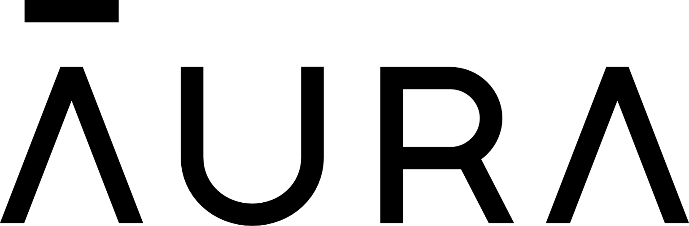
MetLife Now Offers Identity and Fraud Protection to Help Support Everyday Employee Needs
MetLife has entered into an agreement with Aura to offer an industry-leading digital protection solution, further differentiating MetLife.
About Aura
Digital-first technology company
Dedicated to creating a safer internet for everyone
Top-rated company in Identity Theft Protection¹
High customer satisfaction scores
Focus on prevention and proactively protecting data
DTC & Group channels
Complete identity & fraud prevention
Tiered plan options and competitive group pricing
Seamless onboarding
& account set-up
One MetLife contact
& one bill
Benefit from
MetLife’s expertise in employee benefits
1 - https://www.consumersadvocate.org/id-theft-protection/c/aura-identity-theft-protection-review. 2022 IdentityGuard is an Aura owned company
Notes:
Why this is important to our strategy… why now

Slide 18

Questions

